Slide 1



Slide 2
Table of contents
Asset Class Performance to 31 July 2025
SA Equity Performance to 31 July 2025
Commodities Performance to 31 July 2025
Global Market Performance to 31 July 2025
SA Markets
Resources vs Financials vs Industrials
Earnings per share and price-earnings ratios
South African Volatility Index (SAVI)
Exchange Rate overview (CPI - Best Fit)
Interest rates and bond yields
Bond Yields
Equity Yields vs Interest Rates
MSCI vs Earnings
MSCI EM vs Earnings
Global Markets Overview
MSCI Relative Price-Earnings Ratios (Trailing)
MSCI and SWIX Relative Price-Earnings Ratios (Trailing)
Global market volatility
Global Bonds
SA Rand against the US Dollar, Pound & Euro (12 months)
SA Rand against the US Dollar, Pound & Euro (5 years)
Exchange Rates (USDZAR)
Exchange Rates (GBPZAR)
Exchange Rates (EURZAR)
SA equities vs. global developed & emerging markets (12 months)
SA equities vs. global developed & emerging markets (5 years)
US Institute for Supply Management Index
SA Purchasing Managers Index
Gold Price (USD)
Brent Crude Price per Barrel (USD)
Platinum Price (USD)
Conclusion
Disclaimer

Slide 3
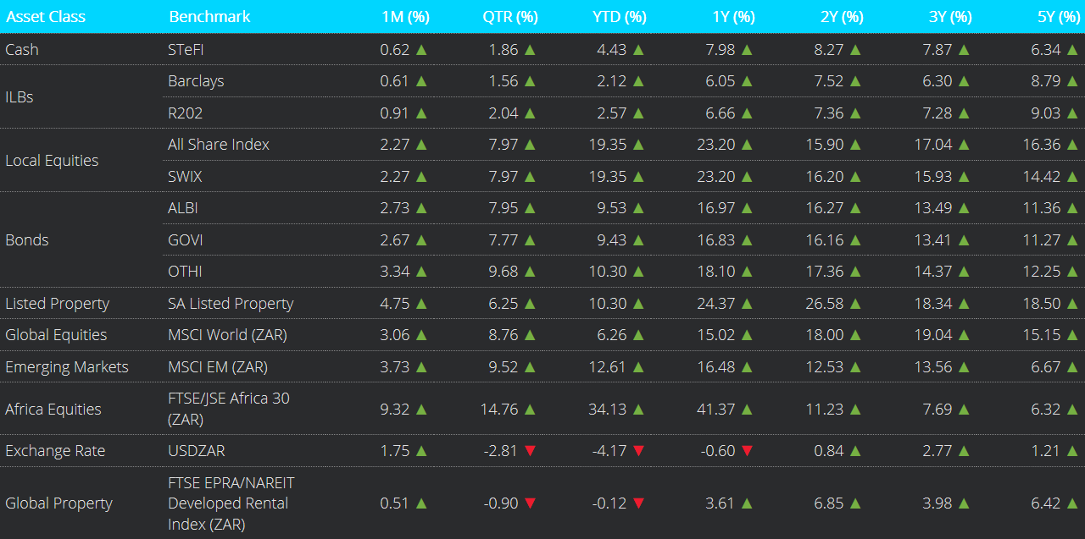
Asset Class Performance to 31 July 2025
Notes:
Global equity markets maintained a positive tone in July, with global equities advancing amid improving risk sentiment and easing trade tensions. The MSCI World index gained 1.29% for the month, pushing year-to-date (YTD) returns into double digits at 10.88%. The US reached agreements with Japan and the European Union, setting a 15% tariff rate on imports, which, while higher than pre-Trump rates, reduced fears of an escalating trade war. The IMF raised its 2025 global economic growth forecast to a range between 2.7% and 3.0%, with stronger projections for major economies.
United States(US) equity markets reached new all-time highs, with the S&P 500 gaining 2.2%, the Nasdaq Composite advancing 3.7%, while the Dow Jones lagged with a modest 0.2% gain for the month of July. Technology stocks led the market, with strong earnings from semiconductor and AI-related companies buoying sentiment.
On a total return basis, SA inflation-linked bonds and nominal bonds were up for the month of July.
The ALBI strengthened by +2.7%, while inflation-linked bonds as measured by the Barclays ILB index increased by +0.6%.
South African listed property posted a stellar gain for the month of July coming in at +4.8%.
In Rand terms, Developed Market (DM) Equities returned +3.1% in July, while Emerging Market (EM) Equities outperformed with a gain of +3.7%.
Africa Equity, in Rand terms, gained +9.3% for the month of July.
The USD/ZAR exchange rate strengthened and ended the month at R18.08.

Slide 4
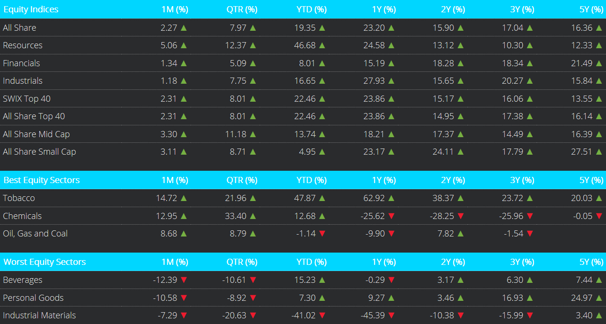
SA Equity Performance to 31 July 2025
Notes:
From a market’s perspective, South African equities as measured by the FTSE/JSE All Share Index posted a gain of +2.3%.
Within equities; Industrials gained +1.2%, Financials gained +1.3%, whilst Resources gained 5.1%.
On a market capitalisation basis, the All Share Top 40 increased by +2.3%, while the All Share Small Cap increased by +3.1%.
The All Share Mid Cap Index gained +3.3%, over July.

Slide 5
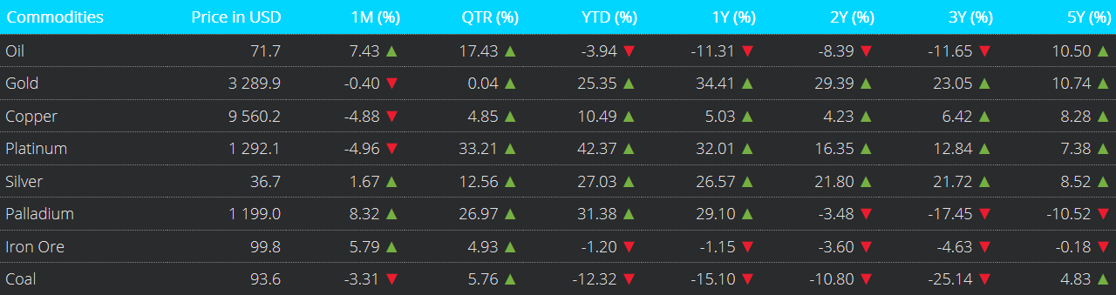
Commodities Performance to 31 July 2025
Notes:
Precious metals had a stronger month of performance in prices overall.
Gold dropped with -0.4% over the month as well as Copper by -4.9%.
Palladium and Silver each gained +8.3%, +1.7% respectively, while Platinum dropped by -5.0%
Over the month of July, oil increased by +7.4%. On a 12-month basis, the price of oil is now -11.3% lower.
The Coal price dropped by -3.3% over the month of July.

Slide 6
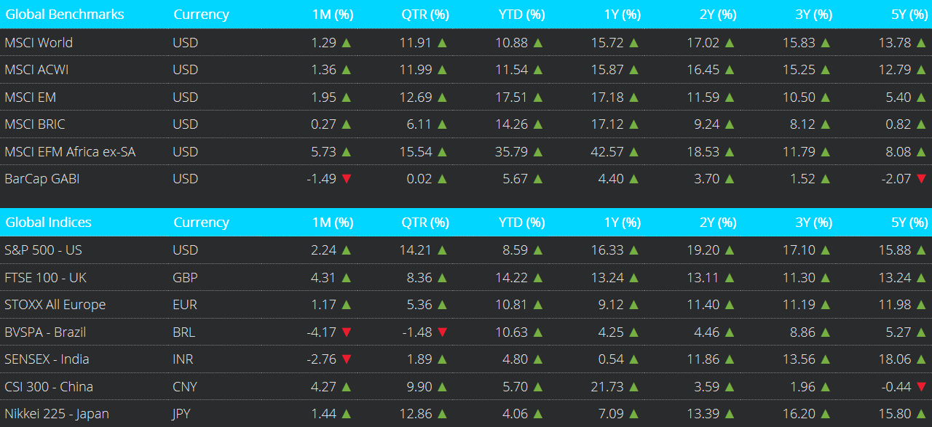
Global Market Performance to 31 July 2025
Notes:
The MSCI World and MSCI All Country World Index (ACWI) both rose by +1.3% and +1.4% respectively in July, while the MSCI Emerging Markets Index outperformed with a gain of +2.0%.
In China, the Caixin Manufacturing PMI rose at 50.8 in July 2025 from 48.5 in June.
The NASDAQ 100 posted an increased of +9.1% for July with the broader S&P 500 index increasing by +2.2%.
UK equities, FTSE 100, closed higher at +4.3% in July.
The broader European index, STOXX All Europe, was up by +1.2%.
The Nikkei 225 saw an increase of +1.4%.
In July 2025, Brazil's BVSPA (Ibovespa) saw a notable decrease of -4.2% . Meanwhile, China's CSI 300 index experienced an increase of +4.3% and India's SENSEX index dropped by +2.8% .

Slide 7
SA Markets
Notes:
The FTSE/JSE All Share Index closed July higher by +2.3%. On a 12-month basis, it has increased by +23.2%.

Slide 8
Resources vs Financials vs Industrials
Notes:
This chart shows the performance of three key South African sector indices: the Resources, Financials, and Industrials subsector.
For the month of July, Industrials registered a gain of +1.2%. Resources and Financials each gained +5.1% and +1.3% respectively.
Across these sectors, Industrials was the best-performing sector on a 12-month view, up by +27.9% followed by a positive performance on the Resources front, returning +24.6%. Financials gained +15.2%.

Slide 9
Earnings per share and price-earnings ratios
Notes:
This chart compares the cumulative return of the All-Share Index, as shown by the yellow line, to its cumulative earnings per share, as shown by the red line.
Earnings per share, experienced a decrease, and still remained above the All-Share index as at the end of July. The All-Share Index continues to appear attractive on a price-to-earnings valuation basis .

Slide 10
South African Volatility Index (SAVI)
Notes:
The South African Volatility Index (SAVI) Top 40 is a forecast of equity market risk in South Africa.
The SAVI saw a decrease in the index from 17.00 in June to 16.44 as at the end of July.
This likely reflects that investors are pricing in lower levels of uncertainty regarding the future path of equity prices.

Slide 11
Exchange Rate overview (CPI - Best Fit)
Notes:
This chart compares the effective Rand-Dollar exchange rate as shown by the yellow line to the Purchasing Power Parity (PPP) Rand-Dollar exchange rate, which is calculated with Consumer Price Inflation, on a best-fit basis.
Using this lens through which to value the Rand against the US Dollar, the local currency remains heavily undervalued.
The PPP-implied exchange rate is approximately R11.50 per USD while the actual exchange as at end July was R18.08 per USD.

Slide 12
Interest rates and bond yields
Notes:
In July, there was a Monetary Policy Meeting (MPC) held on the 31 July 2025 and the repo rate therefore went down to 7.0%.

Slide 13
Bond Yields
Notes:
The yield on the nominal 2-year R186 bond closed July at 7.7%, with longer-dated yields, such as the R2048, expiring in 23 year’s time, posting 10.8% for the month.

Slide 14
Equity Yields vs Interest Rates
Notes:
This chart depicts equity earnings yields, shown by the yellow line, relative to bond yields as shown by the red line. ​​
​​
In July, the R186 bond yield decreased and equity yields decreased. The gap between the two has widened over time, with the R186 nominal bond offering more value relative to the FTSE JSE All-Share Index. ​​
​

Slide 15
MSCI vs Earnings
Notes:
This chart compares the MSCI World Index, Developed Markets, price growth with the earnings growth of the underlying companies within the index over time.
The price index continues to rise as US tech companies lead the way, with an upward jump movement over July.
The earnings of the index has remained relatively stable over the past 12-18 months, with a more recent uptick over from November.

Slide 16
MSCI EM vs Earnings
Notes:
This chart compares the MSCI Emerging Markets Index price growth with the growth of its earnings per share over time.
The price growth increased significantly over the month of July within the MSCI Emerging Market space.
Earnings per share decreased over July.

Slide 17
Global Markets Overview
Notes:
This chart depicts the long-term performance of various MSCI indices.
The long-term trend remains in place: Developed and Emerging Markets outperform Frontier and Emerging Frontier African markets.
For the approximate 16-year period under consideration, the Frontier Markets and the Africa ex. SA indices have been flat-to-negative, though in recent months, Frontier Markets returns have turned positive

Slide 18
MSCI Relative Price-Earnings Ratios (Trailing)
Notes:
In this chart we depict the price-earnings or PE ratios for various MSCI Indices using the past 12 months earnings i.e., trailing earnings.
With the overall market movements observed in July, the MSCI World and MSCI EFM Africa ex-ZA P/E ratios increased slightly; while the MSCI FM and MSCI EM dropped slightly .

Slide 19
MSCI and SWIX Relative Price-Earnings Ratios (Trailing)
Notes:
Here we depict the trailing price-earnings or PE ratios for the various MSCI Indices shown in the previous slide and now include the SWIX index as shown by the blue line.
As we overlay the SWIX to the previous graph, we can see that the PE ratio of the SWIX broadly follows suit with its EFM counterpart, although currently, the MSCI EFM Africa index is trading at a discount relative to SWIX.

Slide 20
Global market volatility
Notes:
The VIX, a real-time index that tracks market sentiment (fear and greed) relating to the S&P 500.
A low VIX typically implies less market uncertainty, and improved investor confidence in the short-term.
A rising and/or high VIX reading implies the opposite.
The VIX decreased over the month, from 16.73 in June to 16.72 in July.

Slide 21
Global Bonds
Notes:
The Bloomberg Barclays Global Aggregate Bond Index (BarCap GABI) decreased by -1.5% in USD terms over July.
On a 12-month view, it has increased by +4.4%.

Slide 22
SA Rand against the US Dollar, Pound & Euro (12 months)
Notes:
This chart depicts the performance of the South African Rand against the US Dollar, Great British Pound and the Euro over the 12 months to end July 2025.
Over the 12-month period, the Rand dipped at the beginning of July, but it is seeing a recovery into the rest of 2025. The Rand ended the period stronger against USD. The Rand is weaker against the Euro and Pound than it was 12 months ago.

Slide 23
SA Rand against the US Dollar, Pound & Euro (5 years)
Notes:
Here we see the 5-year performance of the local currency against the US Dollar, Pound and Euro.
On this time-frame, the Rand is weaker against all major currencies over this period.

Slide 24
Exchange Rates (USDZAR)
Notes:
The long-term performance of the Rand/US Dollar exchange rate.
The local currency depreciated by 1.6% against the US Dollar over July 2025; it is 2.3% weaker against the US Dollar relative to 12 months ago.

Slide 25
Exchange Rates (GBPZAR)
Notes:
The long-term performance of the Rand/British Pound exchange rate.
The local currency depreciated by 0.1% against the British Pound over July 2025; it is 3.9% weaker against the British Pound relative to 12 months ago

Slide 26
Exchange Rates (EURZAR)
Notes:
Long-Term EUR/ZAR Performance
The South African Rand depreciated by -0.3% against the Euro during July 2025. Over the last 12 months, the Rand is 5.6% stronger versus the Euro.

Slide 27
SA equities vs. global developed & emerging markets (12 months)
Notes:
This chart depicts the 12-month performance of the All-Share Index, MSCI World and the MSCI Emerging Markets Indices in Rand terms.
The All-Share Index boasts the highest gain relative to the MSCI World and Emerging markets over a 12-month period.

Slide 28
SA equities vs. global developed & emerging markets (5 years)
Notes:
On this chart we see the performance of the indices shown in the previous slide over the 5 years to end July 2025.
On this time-frame, the MSCI EM Index is the relative laggard as of end July.
The All-Share Index in Rand terms continues to lead.

Slide 29
US Institute for Supply Management Index
Notes:
The ISM Manufacturing PMI decreased slightly from 49.0 in June to 48.0 in July 2025
This means that the manufacturing segment of the US economy remains in an economic contraction phase.
A reading of this index of 50 or above implies economic expansion, while a reading of below 50 implies economic contraction.

Slide 30
SA Purchasing Managers Index
Notes:
The seasonally adjusted Absa Purchasing Managers’ Index (PMI) rose to 50.8 in July 2025 from 48.5 in June.
This indicates a strengthening power in manufacturing activity at the end of July.
A reading of this index of 50 or above implies economic expansion, while a reading of below 50 implies economic contraction.

Slide 31
Gold Price (USD)
Notes:
The price of Gold softened in July, closing the month at $3,289.93 per ounce, a slight incline of +0.5% over the month.

Slide 32
Brent Crude Price per Barrel (USD)
Notes:
The price of Brent Crude Oil increased in July, closing the month at $71.70 per barrel, up from $66.74 in June, thereby decreasing by -2.1% over the month

Slide 33
Platinum Price (USD)
Notes:
The price of Platinum decreased in July, closing the month at $1 292.1 per ounce, a decrease of 5.0% over the month.​
​

Slide 34
Conclusion

Slide 35
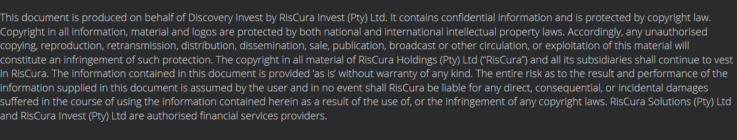
Disclaimer

