Slide 1
COVID-19 management guidelines
Compiled by Ali S M Jawad
23 March 2020

Slide 2
Clinical syndromes associated with COVID-19
WHO 2020

Slide 3
Clinical syndromes associated with COVID-19
Mild illness
Pneumonia
Severe pneumonia
Acute respiratory distress syndrome
Sepsis
Septic shock
WHO 2020

Slide 4
Mild illness
Patients with uncomplicated upper respiratory tract viral infection may have
non-specific symptoms such as fever, fatigue, cough (with or without sputum production), anorexia, malaise, muscle pain, sore throat, dyspnoea, nasal congestion or headache.
Rarely, patients present with diarrhoea, nausea and vomiting.
Older people and immunosuppressed individuals may present with atypical symptoms. Symptoms due to physiological adaptations of pregnancy or adverse pregnancy events, eg dyspnoea, fever, GI symptoms or fatigue, may overlap with COVID-19 symptoms.
WHO 2020

Slide 5
Pneumonia
Adult with pneumonia but no signs of severe pneumonia and no
need for supplemental oxygen.
WHO 2020

Slide 6
Severe pneumonia
Adolescent or adult: fever or suspected respiratory infection, plus one of:
respiratory rate > 30 breaths/min
severe respiratory distress
SpO₂ ≤ 93% on room air
While the diagnosis is made on clinical grounds, chest imaging may identify or exclude some pulmonary complications.
(adapted from https://apps.who.int/iris/bitstream/handle/10665/77751/9789241548290_Vol2_eng.pdf?sequence=3)
WHO 2020

Slide 7
Acute respiratory distress syndrome (ARDS)
Onset: within 1 week of a known clinical insult or new or worsening respiratory symptoms.
Chest imaging (radiograph, CT scan or lung ultrasound): bilateral opacities, not fully explained by volume overload, lobar or lung collapse, or nodules.
Origin of pulmonary infiltrates: respiratory failure not fully explained by cardiac failure or fluid overload.
Need objective assessment (eg echocardiography) to exclude hydrostatic cause of infiltrates/oedema if no risk factor present.
WHO 2020

Slide 8
Acute respiratory distress syndrome (ARDS)
Oxygenation impairment in adults:
Mild ARDS: 200 mmHg < PaO₂/FiO₂ ≤ 300 mmHg
(with PEEP or CPAP ≥ 5 cmH₂O, or non-ventilated)
Moderate ARDS: 100 mmHg < PaO₂/FiO₂ ≤ 200 mmHg
(with PEEP ≥ 5 cmH₂O, or non-ventilated)
Severe ARDS: PaO₂/FiO₂ ≤ 100 mmHg
(with PEEP ≥ 5 cmH₂O, or non-ventilated)
When PaO₂ is not available, SpO₂/FiO₂ ≤ 315 mmHg suggests ARDS
(including in non-ventilated patients).
WHO 2020

Slide 9
Sepsis: adults
Life-threatening organ dysfunction caused by a dysregulated host
response to suspected or proven infection.
Signs of organ dysfunction
Altered mental status
Difficult or fast breathing
Low oxygen saturation
Reduced urine output
Fast heart rate, weak pulse, cold extremities
or low blood pressure, skin mottling
Laboratory evidence of:
Coagulopathy
Thrombocytopenia
Acidosis
Raised lactate
Hyperbilirubinaemia
WHO 2020

Slide 10
Septic shock
Adults
Persisting hypotension despite volume resuscitation, requiring vasopressors to maintain MAP ≥ 65 mmHg
and
Serum lactate level > 2 mmol/L.
WHO 2020

Slide 11
Spectrum of disease
Summary of a report of 72,314 cases from the Chinese Center for
Disease Control and Prevention:
Mild (no or mild pneumonia): 81%
Severe disease (eg with dyspnoea, hypoxia or >50% lung involvement on imaging within 24 to 48 hours): 14%
Critical disease (eg with respiratory failure, shock or multi-organ dysfunction): 5%
Overall case fatality rate was 2.3%; no deaths were reported among non-critical cases
Wu Z, McGoogan JM. Characteristics of and important lessons from the coronavirus disease 2019 (COVID-19) outbreak in China. J Am Med Assoc 2020 (in press) https://doi.org/10.1001/jama.2020.2648

Slide 12
Home care
Home management is appropriate for those with mild infection who can be adequately isolated in the outpatient setting. It is important to focus on prevention
of transmission to others and monitoring for clinical deterioration, which should prompt hospitalisation.
Outpatients with COVID-19 should isolate at home, separating themselves from other households and animals. They should wear
a facemask when in the same room as other people and when presenting to healthcare settings.
Disinfection of frequently touched surfaces is also important.
McIntosh Uptodate 2020

Slide 13
Home care
When a test-based strategy is used, patients may discontinue home isolation when there is:
resolution of fever without the use of fever-reducing medications and
improvement in respiratory symptoms (cough, shortness of breath) and
negative results of a US FDA Emergency Use Authorised molecular assay for COVID-19 from at least two consecutive nasopharyngeal swab specimens collected ≥ 24 hours apart (total of two negative specimens).
McIntosh Uptodate 2020

Slide 14
Home care
When a non-test-based strategy is used, patients may discontinue home isolation when the following criteria are met:
at least 7 days have passed since symptoms first appeared and
at least 72 hours have passed since recovery of symptoms (defined as resolution
of fever without the use of fever-reducing medications and improvement in respiratory symptoms (cough, shortness of breath))
McIntosh Uptodate 2020

Slide 15
Hospital care
Some patients with suspected or documented COVID-19 have severe disease
requiring hospital care.
Management of such patients consists of ensuring appropriate infection control.
Patients with severe disease often need oxygenation support.
The safety of high-flow oxygen and non-invasive positive pressure ventilation in these measures is uncertain, and they should be considered aerosol-generating procedures that warrant specific isolation precautions.
If patients develop acute respiratory distress syndrome, intubation with mechanical ventilation will be needed.
ECMO (extracorporeal membrane oxygenation) may be indicated in patients with refractory hypoxia. McIntosh Uptodate 2020

Slide 16
NICE rapid COVID-19 guidelines
The National Institute for Health and Care Excellence (NICE) has published its first three rapid COVID-19 guidelines

Slide 17
NICE guideline (NG159) – Critical care
All patients admitted to hospital should be assessed for frailty irrespective of
COVID-19 status.
Risks and benefits and likely outcomes should be discussed with patients, carers or advocates and families using decision-support tools (where available) so that they can make informed decisions about their treatment wherever possible.
For patients with confirmed COVID-19, decisions about critical care admission should be made on the basis of medical benefit and should take into account the likelihood that the person will recover to an outcome that is acceptable to them and within a period of time consistent with the diagnosis.

Slide 18
NICE guideline (NG160) – Dialysis
Patients with suspected COVID-19 should be assessed to see whether dialysis could be delayed until their COVID-19 status is known.
NICE also recommends that outpatient transport services should get patients to their dialysis as scheduled to avoid their condition deteriorating.
It should also be ensured that appropriate transport services are available by finding out what current transport providers are prepared to provide, and whether there are alternative providers if the current providers will not transport patients infected with COVID-19.

Slide 19
NICE guideline (NG161) – Systemic cancer treatments
Where decisions need to be made about prioritising patients for treatment, these need to take into account the level of immunosuppression associated with individual treatments and cancer types, and any other patient-specific risk factors. They should also balance the risk from cancer not being treated optimally versus the risk of becoming seriously ill if they contract COVID-19 because of immunosuppression.
Where changes need to be made to usual care because of system pressures, consideration should be given to delivering treatment in different and less immunosuppressive regimens, different locations, or via another route of administration.

Slide 20
Chloroquine
Use of chloroquine is included in treatment guidelines from China's National Health Commission and was reportedly associated with reduced progression of disease and decreased duration of symptoms.
However, no published data.
Gao J, Tian Z, Yang X. Breakthrough: Chloroquine phosphate has shown apparent efficacy in treatment of COVID-19 associated pneumonia in clinical studies. Biosci Trends 2020;14:72–3.

Slide 21
Hydroxychloroquine
Hydroxychloroquine (200 mg tds for 10 days) was associated with a higher rate of undetectable viral RNA on nasopharyngeal specimens at day 6 compared with no specific treatment (70 vs 12.5%).
In this study, the use of azithromycin in combination with hydroxychloroquine appeared to have additional benefit, but there are methodological concerns about the control groups for the study, and the clinical basis for using azithromycin is not clear.
Gautret P et al. Hydroxychloroquine and azithromycin as a treatment of COVID‐19: results of an open‐label non‐randomized clinical trial. Int J Antimicrob Agents (in press) https://doi.org/10.1016/j.ijantimicag.2020.105949

Slide 22
Uncertainty about NSAID use
Some clinicians have suggested that the use of NSAIDs early in the course of disease may have a negative impact on disease outcome (Day BMJ 2020;368:m1086. Epub 17 Mar 2020). These are based on anecdotal reports of a few young patients who received NSAIDs early in the course of infection and experienced severe disease. There is also the concern that the anti-inflammatory properties associated with NSAIDs could have a negative impact on the patient's immune response.
Use paracetamol (acetaminophen) in place of NSAIDs for reduction of fever.
However, the European Medicines Agency (EMA) and the WHO do not recommend that NSAIDs be avoided when clinically indicated.
McIntosh Uptodate 2020

Slide 23
Limited role for corticosteroids
The WHO and CDC recommend corticosteroids are not to be used in patients with COVID-19 pneumonia unless there are other indications (eg exacerbation of COPD).
Corticosteroids have been associated with an increased risk of mortality in patients with influenza and delayed viral clearance in patients with Middle East respiratory syndrome coronavirus (MERS-CoV) infection.
Though widely used in management of severe acute respiratory syndrome (SARS), there was no good evidence for benefit, and there was persuasive evidence of adverse harm in the short and long term.
McIntosh Uptodate 2020

Slide 24
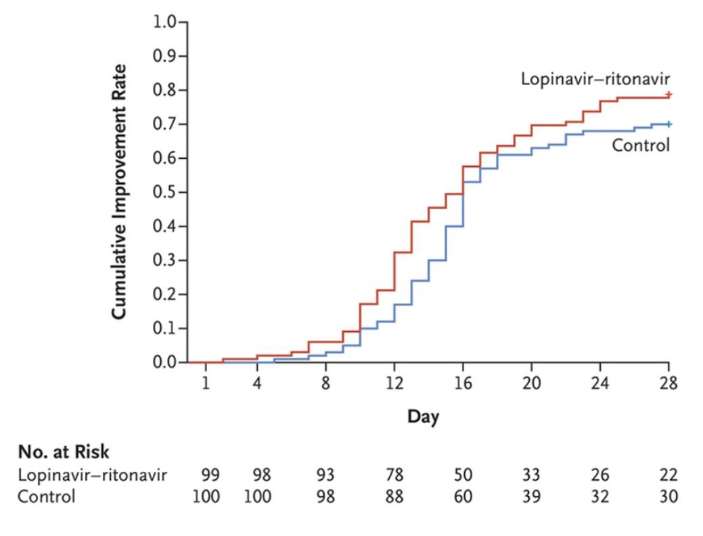
Lopinavir–ritonavir
Investigators in China report the results of an open-label, randomised clinical trial of lopinavir–ritonavir for the treatment of COVID-19 in 199 infected adult patients. There was no difference in the primary end point, time to clinical improvement.
Cao B et al. A trial of lopinavir–ritonavir in adults hospitalized with severe COVID-19. N Engl J Med 2020 (in press) https://doi.org/10.1056/NEJMoa2001282

Slide 25
Remdesivir
Several randomised trials are under way to evaluate the efficacy of remdesivir for moderate or severe COVID-19.
It has activity against SARS-CoV-2 in vitro, SARS and MERS-CoV, both in vitro and in animal studies.
The compassionate use of remdesivir through an investigational new drug application was described in a case report of one of the US patients with COVID-19.
Any clinical impact of the drug on COVID-19 is awaited.
Holshue ML et al. First case of 2019 novel coronavirus in the United States. N Engl J Med 2020;382:929–36.

Slide 26
Tocilizumab
Treatment guidelines from China's National Health Commission include the IL-6 inhibitor tocilizumab for patients with severe COVID-19 and elevated IL-6 levels.
A clinical trial is under way.
Reuters. China approves use of Roche drug in battle against coronavirus complications. www.reuters.com/article/us-health-coronavirus-china-roche-hldg/china-approves-use-of-roche-arthritis-drug-for-coronavirus-patients-idUSKBN20R0LF [Accessed on 21 March 2020].

Slide 27
Summary
Once COVID-19 is diagnosed, identify which syndrome and decide on
home or hospital care.
Treat each syndrome accordingly.
Use paracetamol as fever-lowering agent.
Use hydroxychloroquine for most patients.
Avoid corticosteroids and NSAIDs.

Slide 28
Thank you

